Slide 1
API & Shader Debugging
3DCC DAY2

Slide 2



COMMON API AGNOSTIC PITFALLS

Slide 3
IGNORING THE CONSOLE/OUTPUT WINDOW
If you can’t figure out what an error means, that doesn’t mean you should ignore it. Its ok to ask each other what they mean!
Eventually you will begin to understand them, but until then web search and discussion will help! (ask in our Discord channel)
This doesn’t mean people can fix your code for you, we can just help you understand what is wrong so YOU can fix it.

Slide 4
SHADERS DEFAULT TO COLUMN MAJOR MATRICIES
If everything seems right but nothing shows up this could be why.
Many CPU math libraries are ROW MAJOR. (ex: Gateware, DirectXMath)
This means after you send a matrix to the GPU everything gets mixed up.
There are three common solutions:
Use special commands in the shader language to switch them to ROW MAJOR.
Mathematically Transpose a copy of your matrix data before you send it.
Reverse the order or multiplication in the shader. (Ex: Projection * View * World * pos)

Slide 5


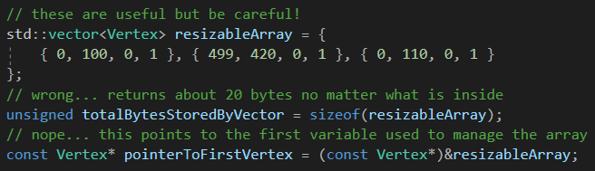
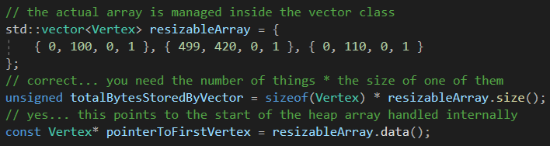
Incorrect use of STD library VECTOR class
At some point you're probably going to want to use std::vector for data.
It’s a useful and convenient data structure if you understand how it works.
A std::vector is NOT an array. An std::vector MANAGES a resizable array.
If you treat your std::vector like its a raw array, you will run into problems!

Slide 6
DEBUGGING SHADERS (API DEBUGGING)
Unlike CPU debugging, the built in IDE debugger is generally not capable of inspecting a graphics API since much of what you do happens on the GPU.
A more specialized tool built specifically for this purpose will be necessary.
Many such tools have come and gone over time, but generally there are three common options depending on the API in use:
The Visual Studio Graphics Debugger (Direct3D11 only)
Microsoft PIX (Direct3D12 only)
RenderDoc (Direct3D11/12, Vulkan, OpenGL)

Slide 7
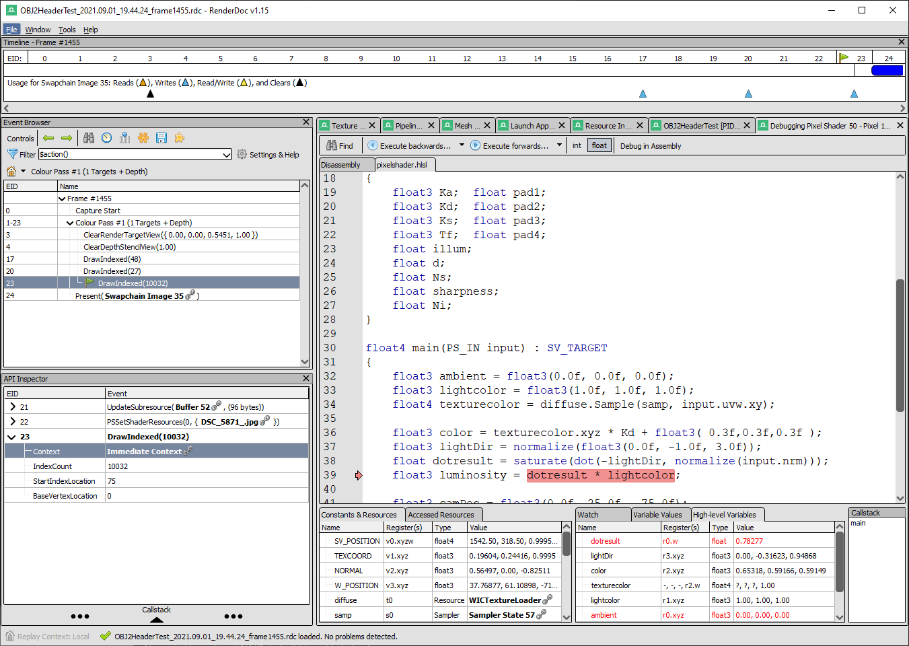
Renderdoc
An incredibly powerful and versatile development tool, RenderDoc enables pipeline and shader debugging on nearly every graphics API available!
Use it to launch the Debug executable of your program. It will capture the various calls to the GPU so you can inspect what is really going on.
There is a short learning curve, but once you get to grips with it you will wonder how you ever wrote anything without it!

Slide 8
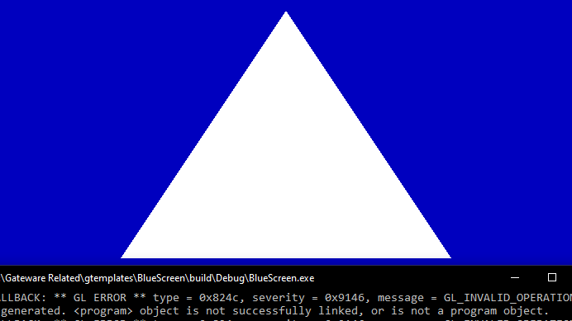
DEMO: Where is the debug output?

Slide 9

DEMO: LETS USE RENDERDOC

Slide 10
Resources & Examples
Video recording of how to use RenderDoc.
Passcode: BndU%3u0
RenderDoc is great but it is not your only option!
Did you know you can Analyze your Steam collection?

Slide 11
Q

